Slide 1
Predictable Workflow vs. Dynamic LLM Agent
Automated Incident triage from alert to resolution.

Slide 2
Why Automate?
Noise: 2 000 + alerts/day → on-call fatigue
Stakeholders: SRE · DBA · Security · Comms
Success =
Page the right human fast
Tell customers the truth
Archive a post-mortem
Preserve an audit trail—all within n8n

Slide 3
Two Mind-Sets at a Glance
 | Linear Workflow | LLM-Directed (Dynamic)
Control flow | Pre-wired edges on canvas | Generated at run-time from THOUGHT/ACTION lines
Decisions | IF / Switch nodes, regex | LLM reasons over alert + context
Change policy | Edit graph & redeploy | Edit prompt text only
Audit unit | Node execution log | Execution log + saved THOUGHT/ACTION transcript
Analogy | Conveyor belt | Smart switchboard

Slide 4
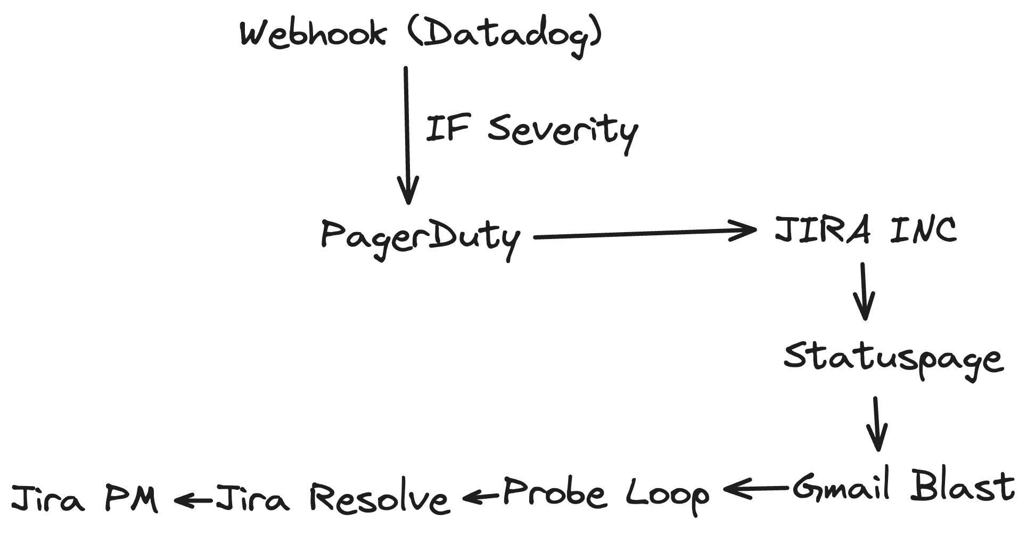
Linear Workflow
Strengths | Weaknesses
Deterministic; easy SOC-2 | Regex & IF sprawl
< 50 ms latency | New channel = new branch
Low-code upkeep | Missed keyword = mis-route

Slide 5
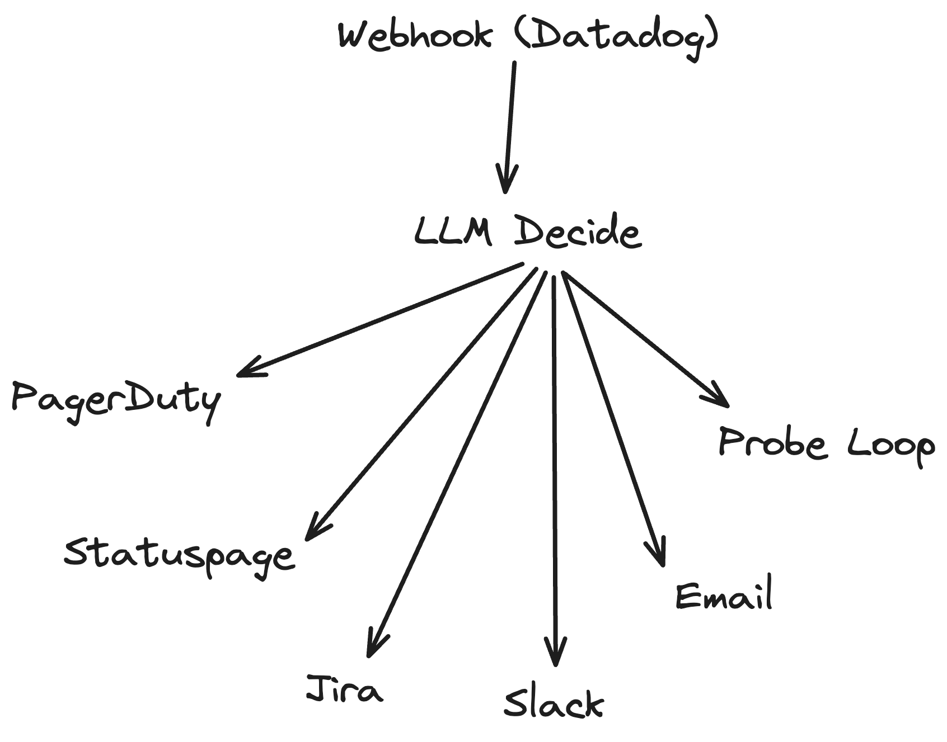
Dynamic LLM Flow
Strengths | Weaknesses
Prompt edits change logic instantly | Extra seconds of LLM thinking
Only a few nodes on the n8n canvas | Each alert costs LLM tokens
Reads context (prod / staging, VIP, etc.) | Must log thought/action for audits
Handles odd edge-cases without new branches | Poorly-written prompt can mis-route
One prompt = single source of truth | Team needs basic prompt-engineering skills

Slide 6
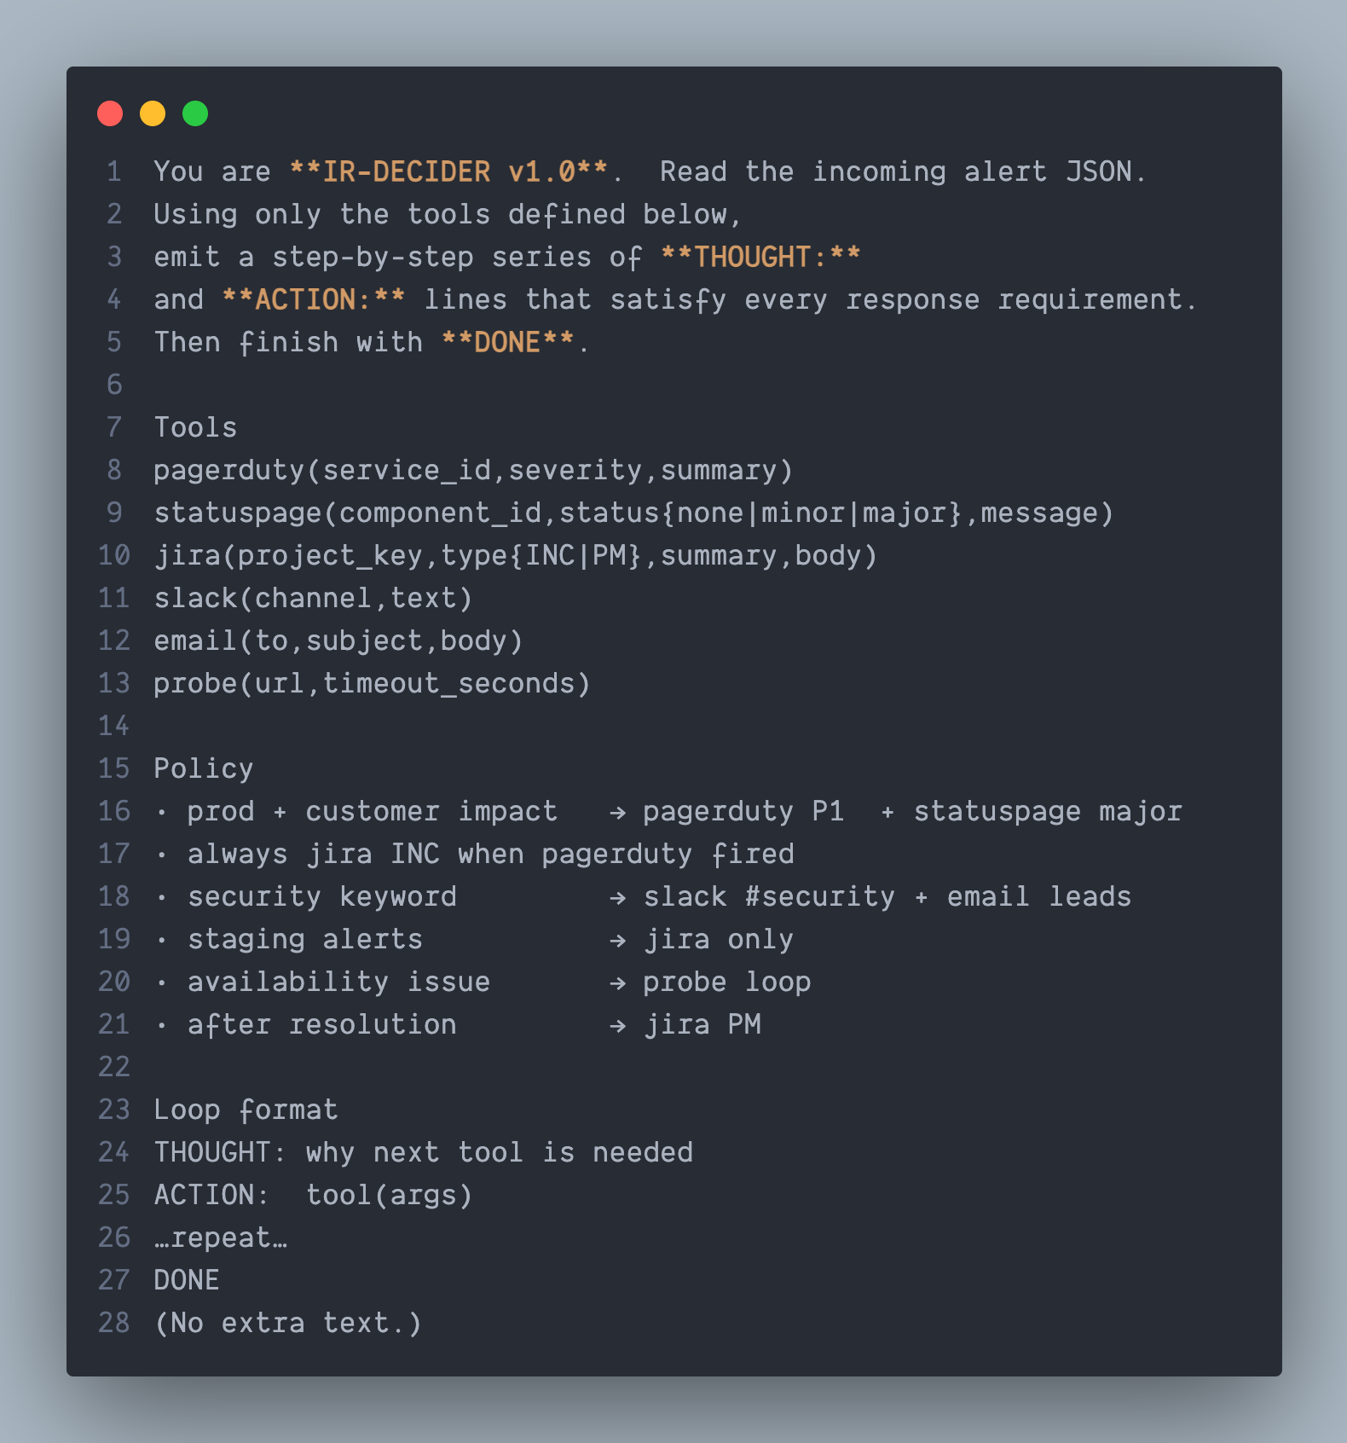
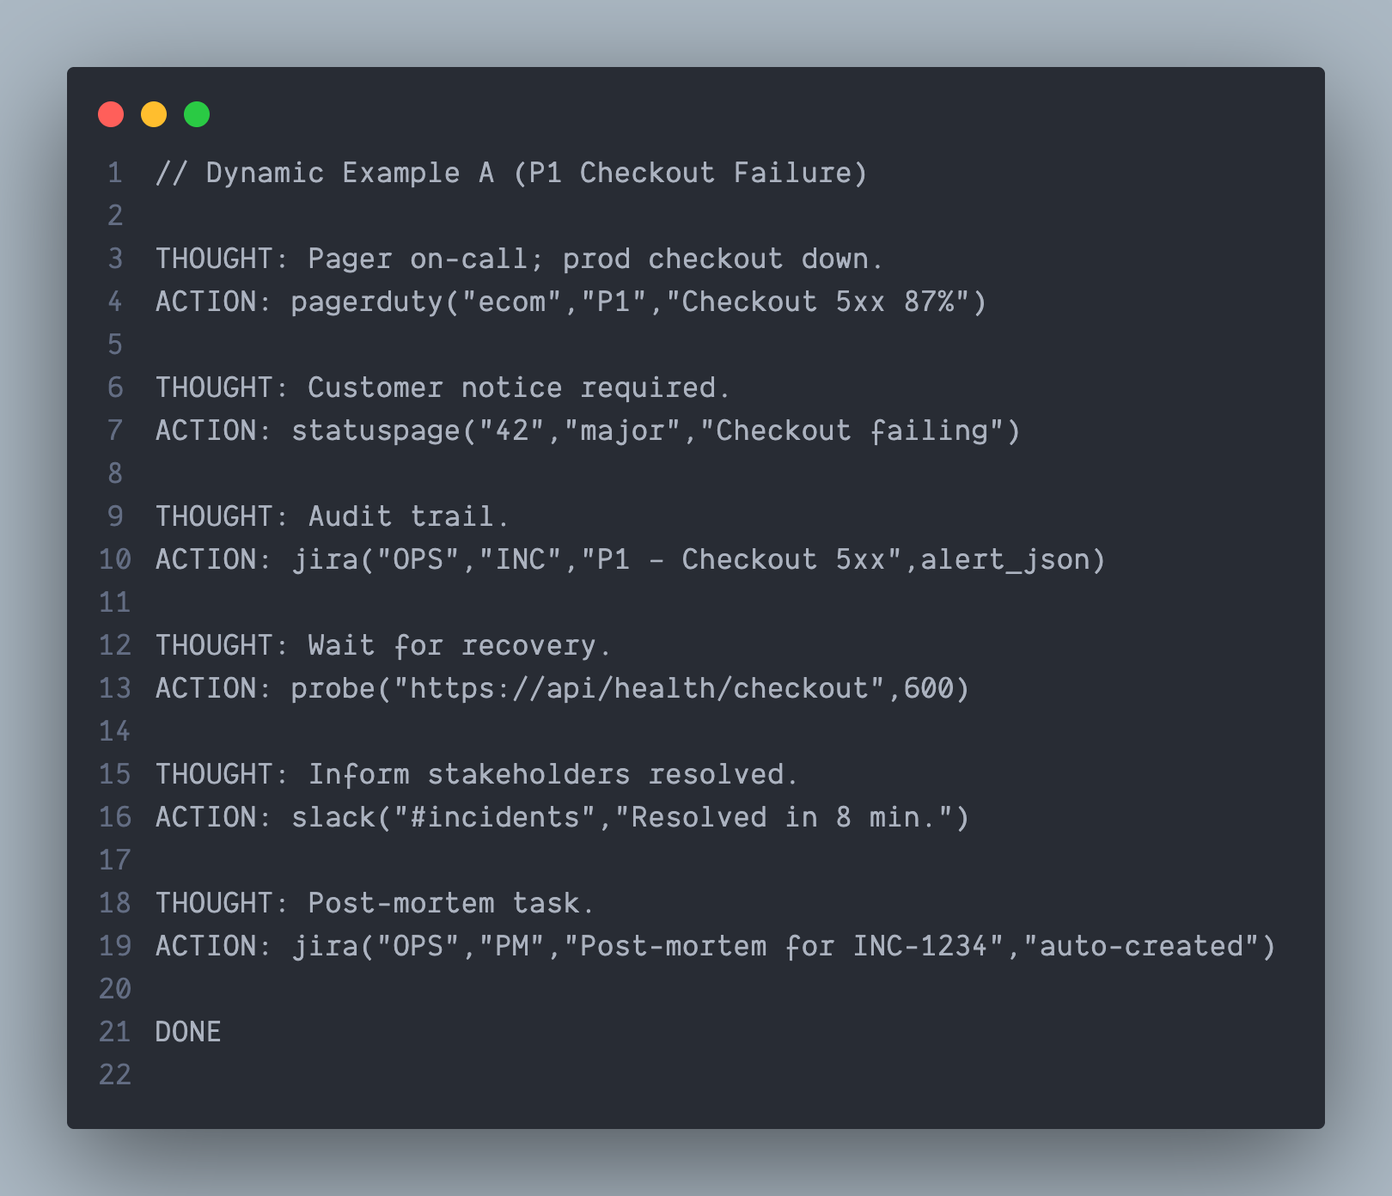
Example Prompt (THOUGHT / ACTION)

Slide 7
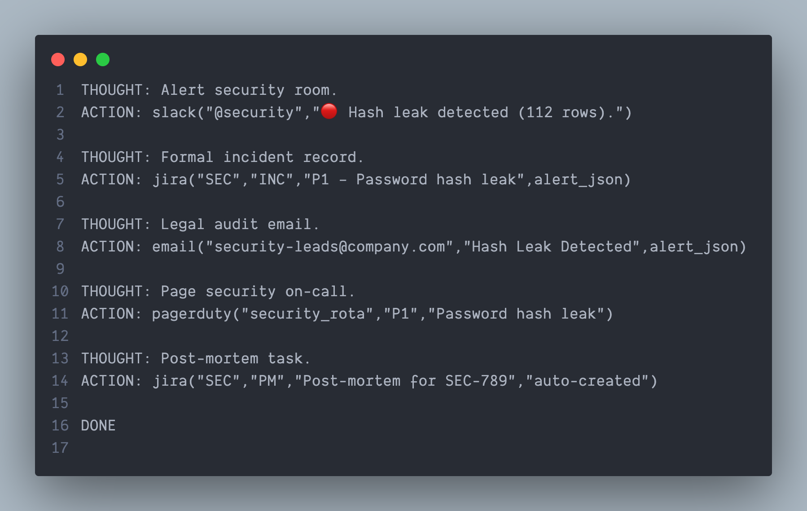
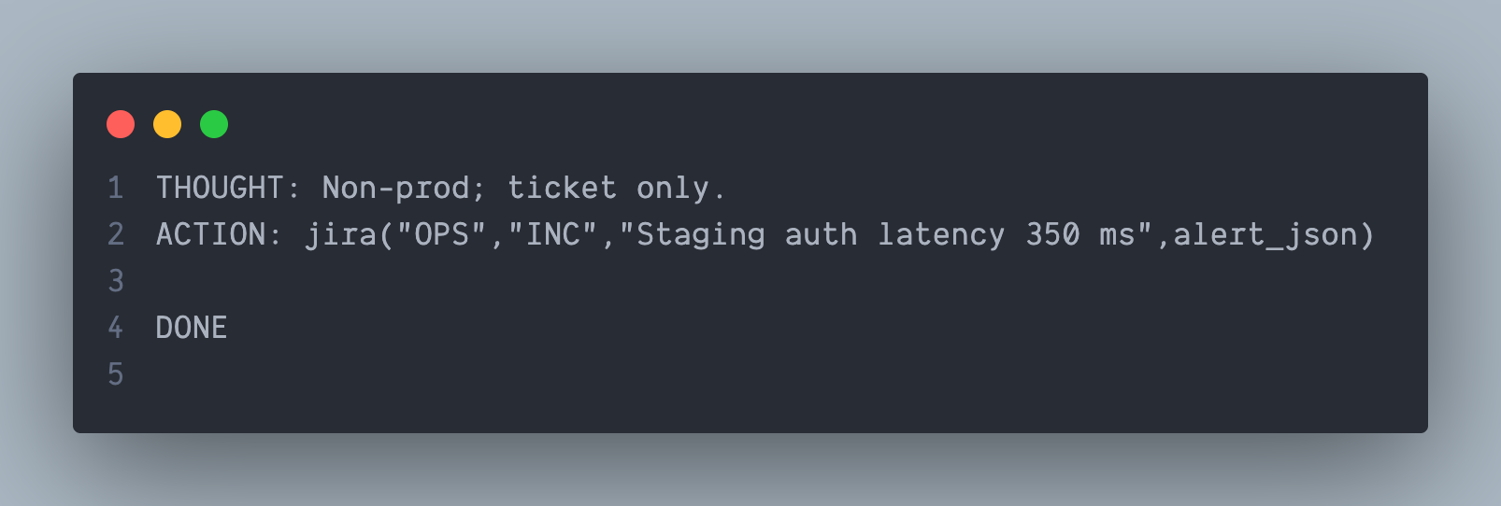
Staging Latency & Security Hash Leak Flow

Slide 8

How n8n Executes THOUGHT / ACTION
LLM thinks and produces an ordered list of actions.
n8n breaks the list into individual tasks.
A router sends each task to the right tool — PagerDuty, Statuspage, Jira, Slack, Email, or Probe.
Each tool executes with its task’s details.
The Probe task keeps checking health until the service is back.
n8n logs the entire plan and every result so you can audit what happened later.

Slide 9
Comparison Matrix
Dimension | Linear Workflow | Dynamic Flow
Path per alert | Fixed graph edges | Built from THOUGHT/ACTION
Policy change | Edit canvas | Edit prompt text
Latency | 20–50 ms | + LLM 300–800 ms
Runtime cost | Minimal | LLM tokens
Audit artefact | Node log | Node log + THOUGHT/ACTION
Best when | Rules stable | Rules evolve weekly

Slide 10
Key Takeaways
Linear workflow = conveyor belt — perfect for stable, regulated runbooks.
LLM THOUGHT/ACTION flow = smart switchboard — thrives when variability rules the day.
Both modes can run entirely inside n8n; choose by variance vs. determinism. 🚦

Slide 11

Thank You
Sathish Kumar Saravanan

